Slide 1

Analysis of Airbnb Database
Yen Huynh

Slide 2
Queries and Methods
Get to know information about all the columns from wanted tables.
Use basic methods such as SELECT - FROM, DISTINCT, COUNT, WHERE, GROUP BY, HAVING, ORDER BY, LIMIT,…
Use advanced functions and subquery for complex queries like JOIN, CASE – WHEN – ELSE – END AS, WITH,…
Understand each query’s command and respond with a correct answer/insight in PostgreSQL.

Slide 3
Tables and Columns
Retrieve columns from tables with SELECT * FROM method:
“busiest” table contains columns “busy_date”.
“cal_price” table contains columns “listing_id”, “calendar_date”, “price”.
“cal_price_2” table contains columns “listing_id”, “date_month”, “sum_price”.
“calendar” table contains columns “listing_id”, “calendar_date”, “available”, “price”.
“cheapest” table contains columns “price”, “cheap_date”.
“cheapest1” table contains columns “price”, “cheap_date”.

Slide 4
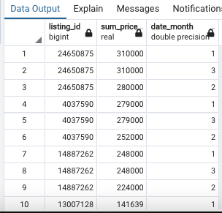
Simple Queries
Retrieve the number of busiest day that aren’t null value:
SELECT COUNT(*) FROM – WHERE the column IS NOT NULL. (result: 365)
Get the month, id, and price of the listing with most price in it and only show 1st quarter year:
SELECT DISTICT columns FROM first table JOIN second table ON their mutual column WHERE date column IN (1,2,3) ORDER BY price DESC(descending order).

Slide 5



Query Contains String/Letter
Show listing that is available in 't' and in the month of May:
SELECT DISTICT listing column FROM first table JOIN second table ON their mutual column WHERE price IS NOT NULL AND available = ‘t’ AND date = 5 ORDER BY listing (ascending order).

Slide 6
Query Contains String/Letter
Which do listing id make the most money from 2019-01 to 2019-02, include its availability as ‘f’:
This long query will be using WITH to name a UNION of 2 tables, then use SELECT DISTINCT – FROM with FULL JOIN twice to join 3 tables, and last FULL JOIN for our new name table with WITH above, WHERE date BETWEEN time 1 AND time 2 AND available = ‘t’, ORDER BY price DESC (descending order) and LIMIT 1.

Slide 7
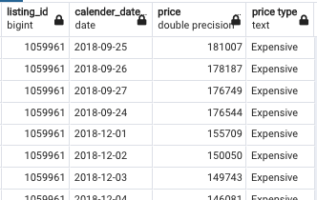
Complex Queries
Put label on prices from previous table:
This query is similar to the previous query, but we use CASE WHEN price = 0 THEN label it as 'Free’ WHEN price > 0 AND price <= 5000 THEN label it as 'Cheap’ WHEN price > 5000 THEN label it as 'Expensive’ ELSE label it as 'Not Determine’ END AS new table name FROM new table with WITH above ORDER BY price descending.

Slide 8
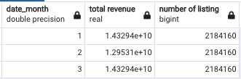
Making Quarterly Report
Making a 1st quarter report based on revenue by first 3 months:
Return 3 columns which are date, total revenue, and number of listing by SELECT the date, SUM of price, COUNT of listing_id ( alias them with an appropriate name), FROM first table JOIN second table on their primary column, GROUP BY date HAVING date IN (1,2,3) ORDER BY date(month).

